Slide 1





Workflow, Build Profiles and Push Profiles for Simulators and Devices Windows (Android)
Fauzi Sholichin
fauzisholih@gmail.com
+6289673732142
https://www.linkedin.com/in/fauzisho/

Slide 2
Introduction
Introduction to common ionic cordova script
Adding the platform to the project
Checking the project requirements
Preparing Emulator or devices
Building Profiles and Push Profiles (Deployed to emulator or device)

Slide 3
Open CMD or Powershell and navigate to project directory
Open Explorer and navigate to the project
Shift + right-click
Choose ‘open command window here’ or ‘open powershell window here’
For advanced user (windows 8 and later)
Press Window + X
Press A
Cd <project_directory>

Slide 4
Common ionic cordova script
ionic integrations enable cordova
ionic cordova platform add android
ionic cordova requirements
Ionic cordova run android / ionic cordova emulate android

Slide 5
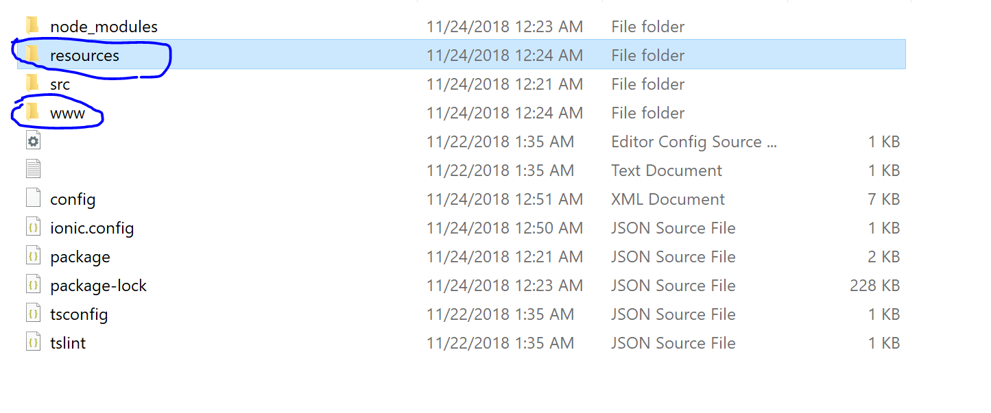
Command: ionic integrations enable cordova
To enable ionic-cordova, a framework to allow html, css and js to be run natively on devices.
More details and refer to https://cordova.apache.org/
Two folder will be added

Slide 6
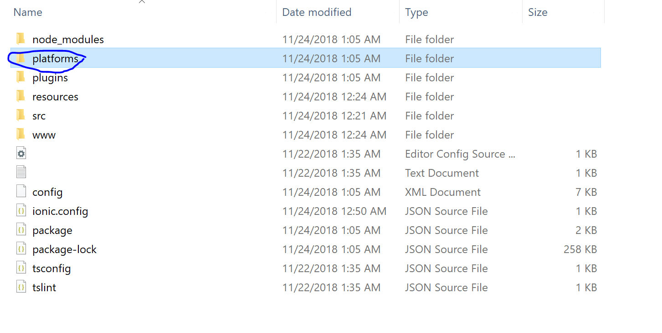
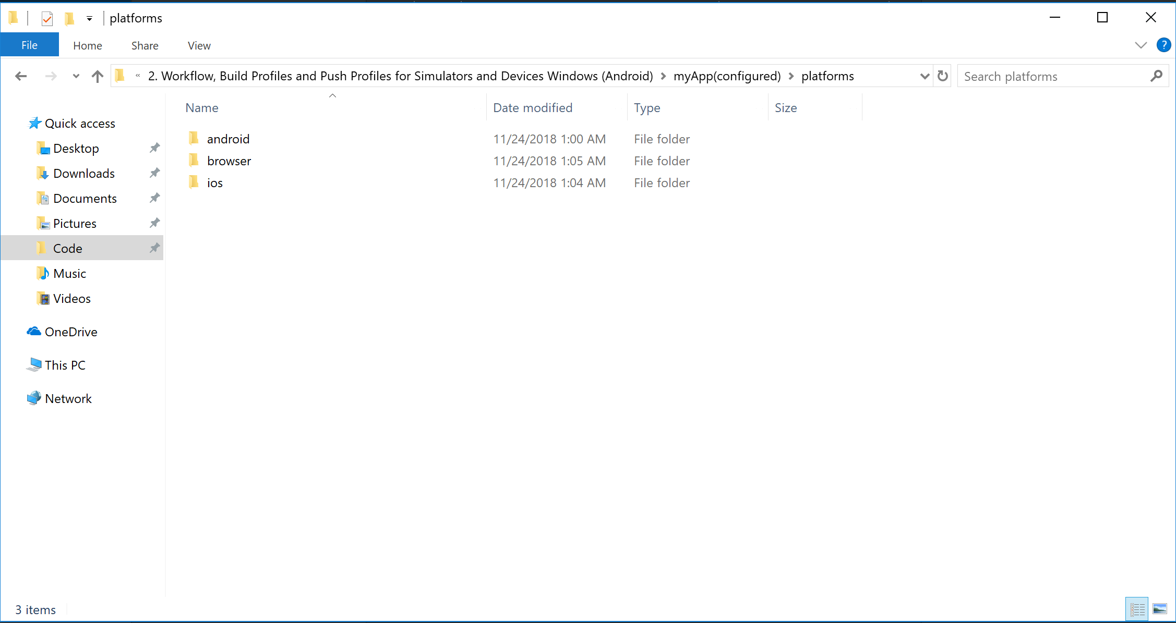
Adding the platform to the project
Command: ionic platform add <platform>
Android
IOS
Browser
OSX
Windows

Slide 7
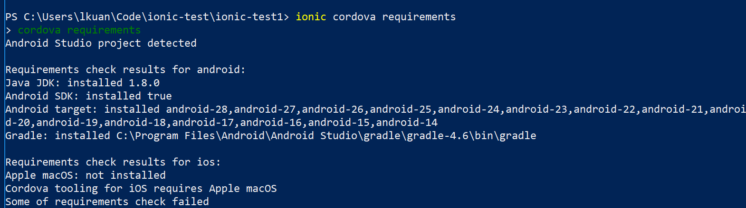
Checking the project requirements
Command: ionic cordova requirements
Check for requirements to build the project

Slide 8
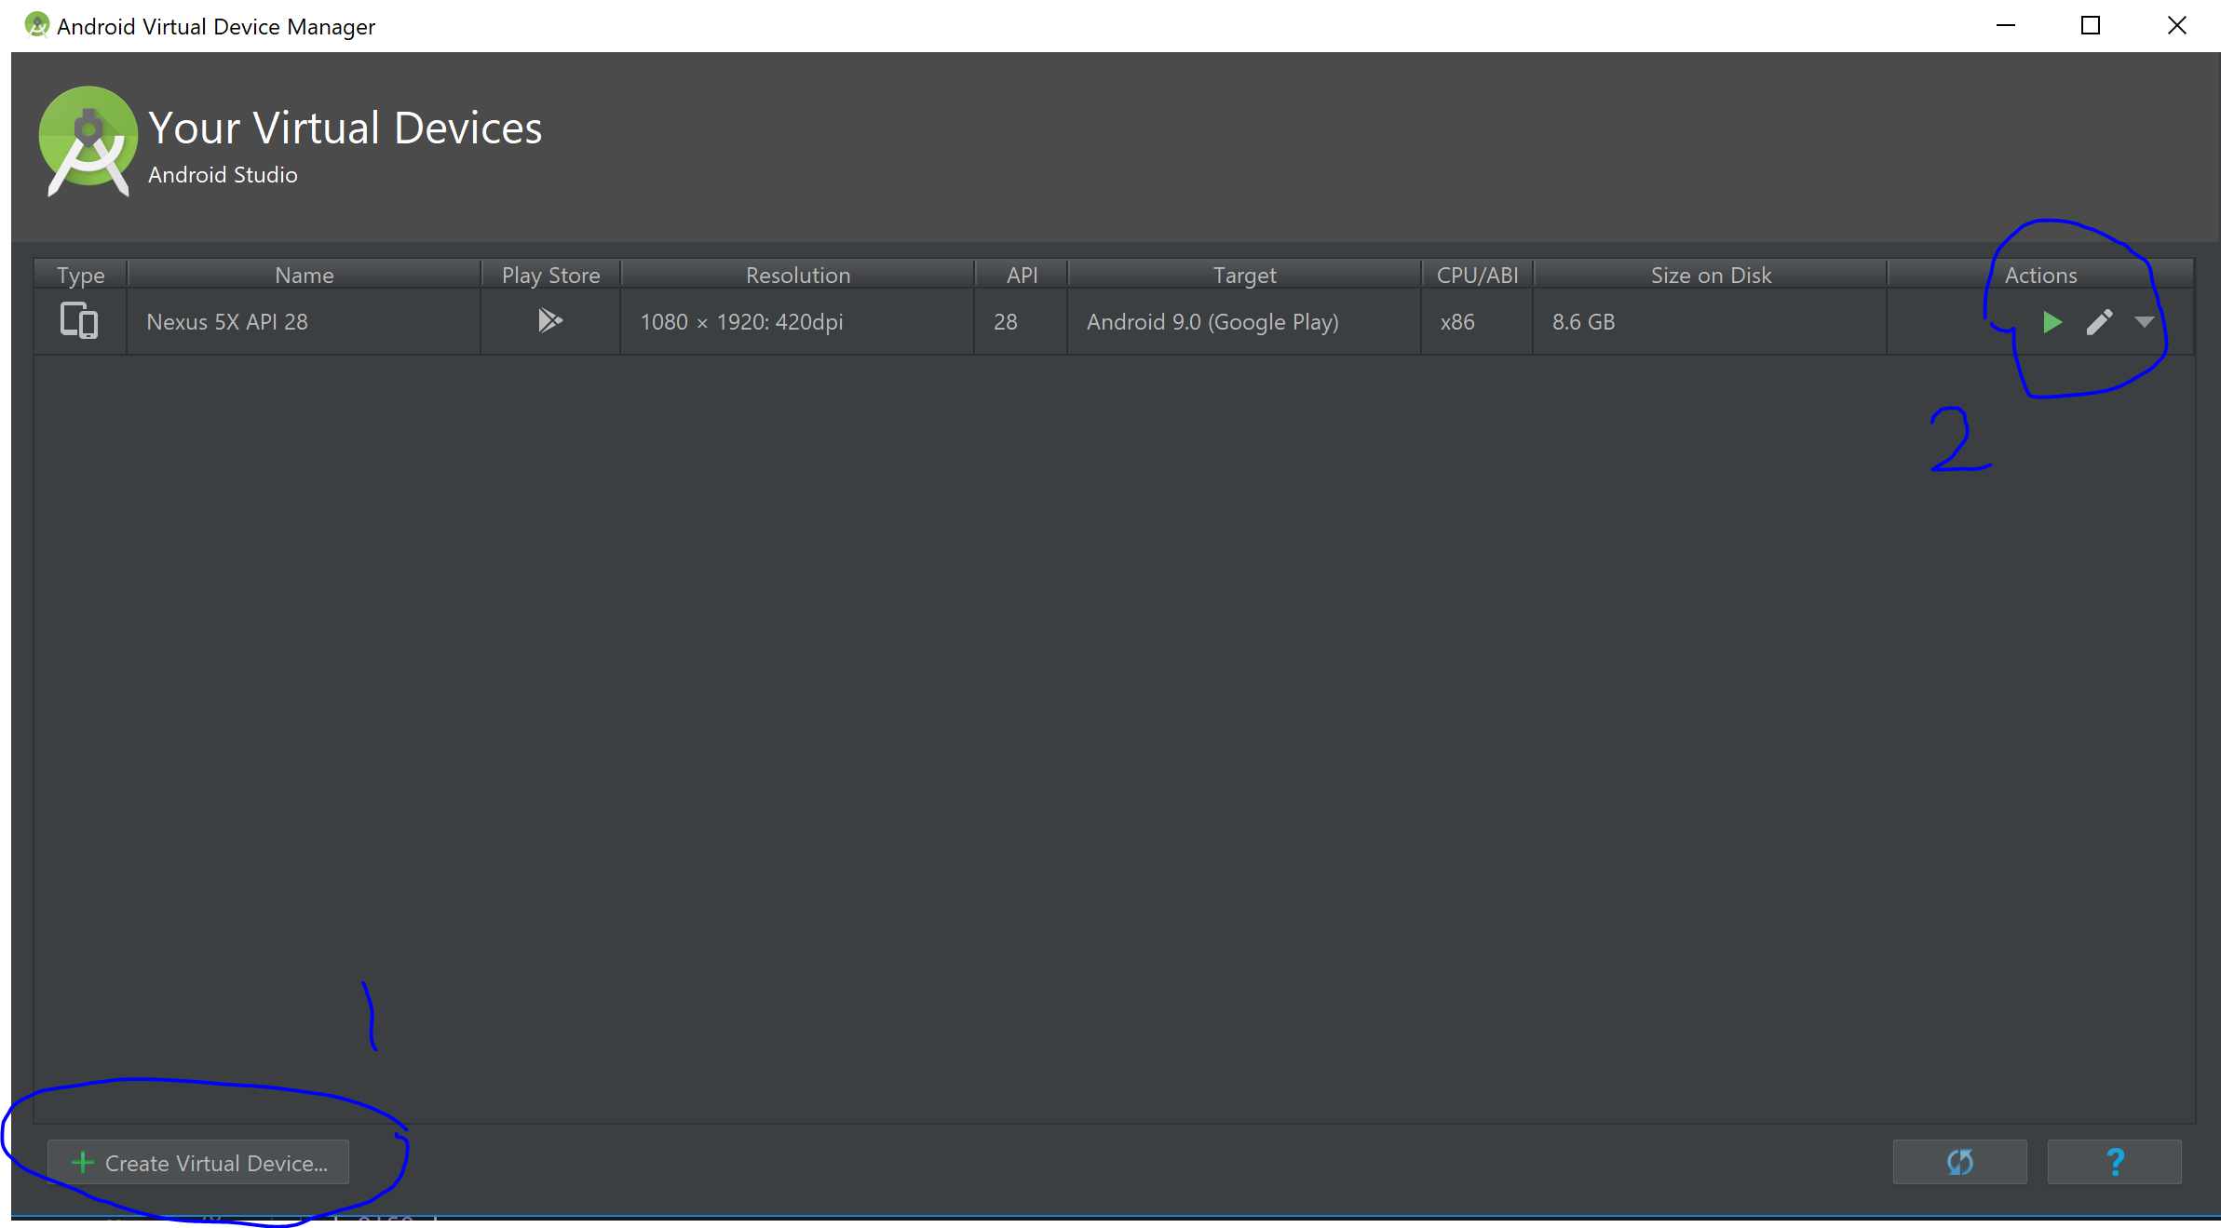
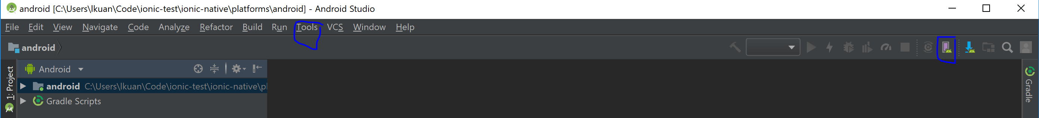
Preparing emulator (GUI)
Open an Android Studio Project
Import the android project
Select Tools > AVD Manager
Create a new emulator
Launch emulator

Slide 9
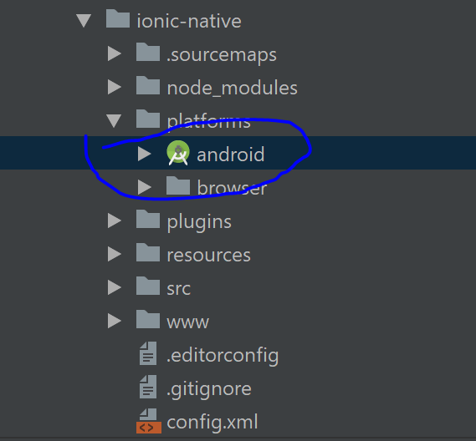
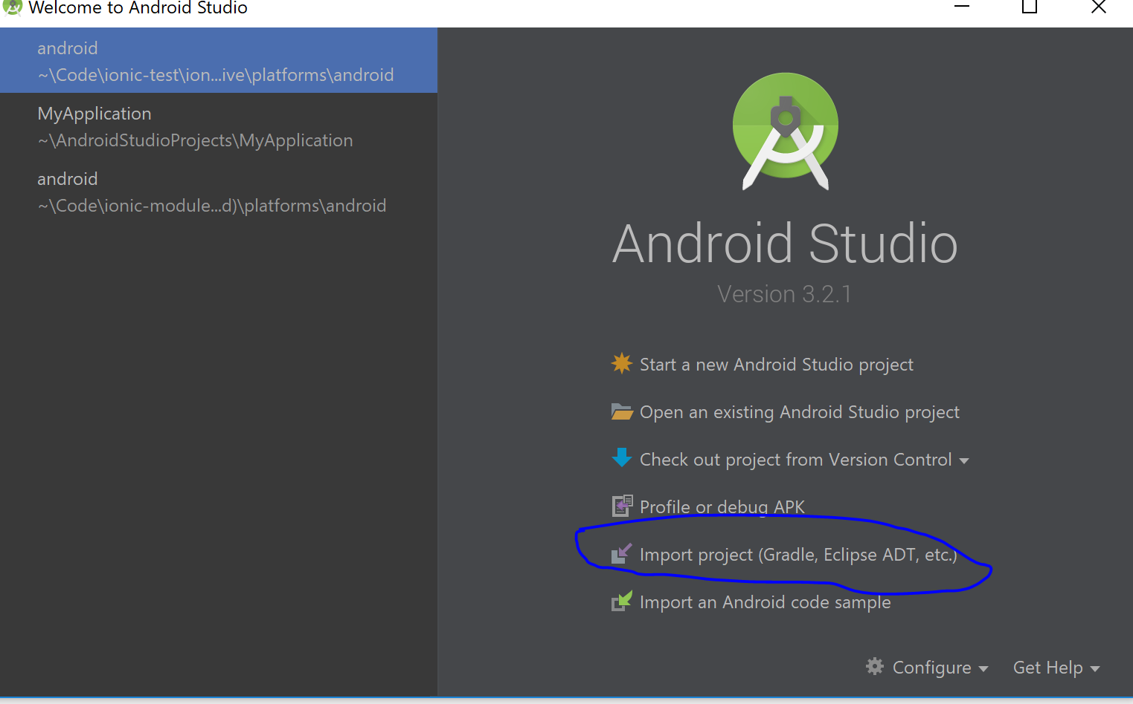
Import existing project

Slide 10
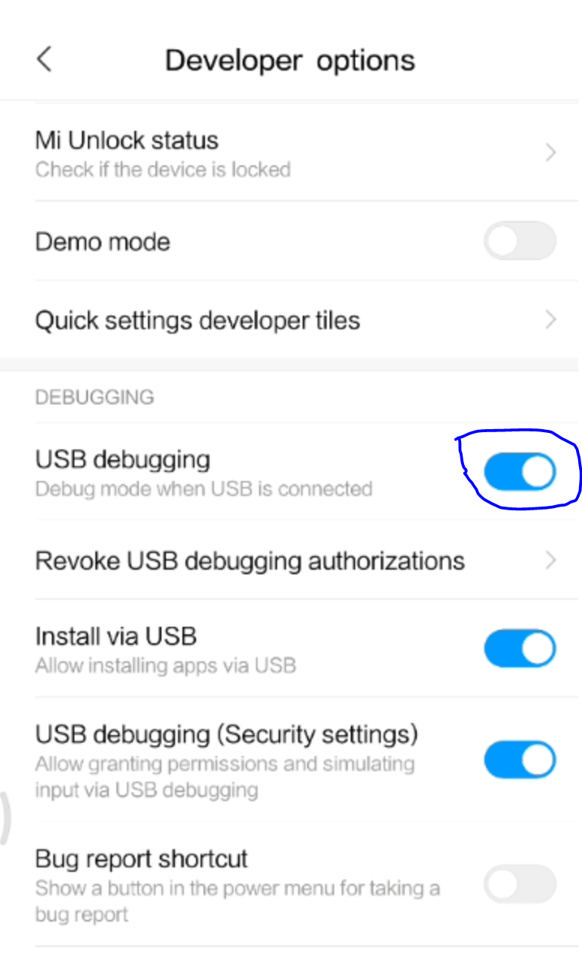
Preparing device
Device dependant
Normal process
Open phone
Navigate to
Settings > About phone > Build number
Enable developer options
Enable USB Debugging

Slide 11
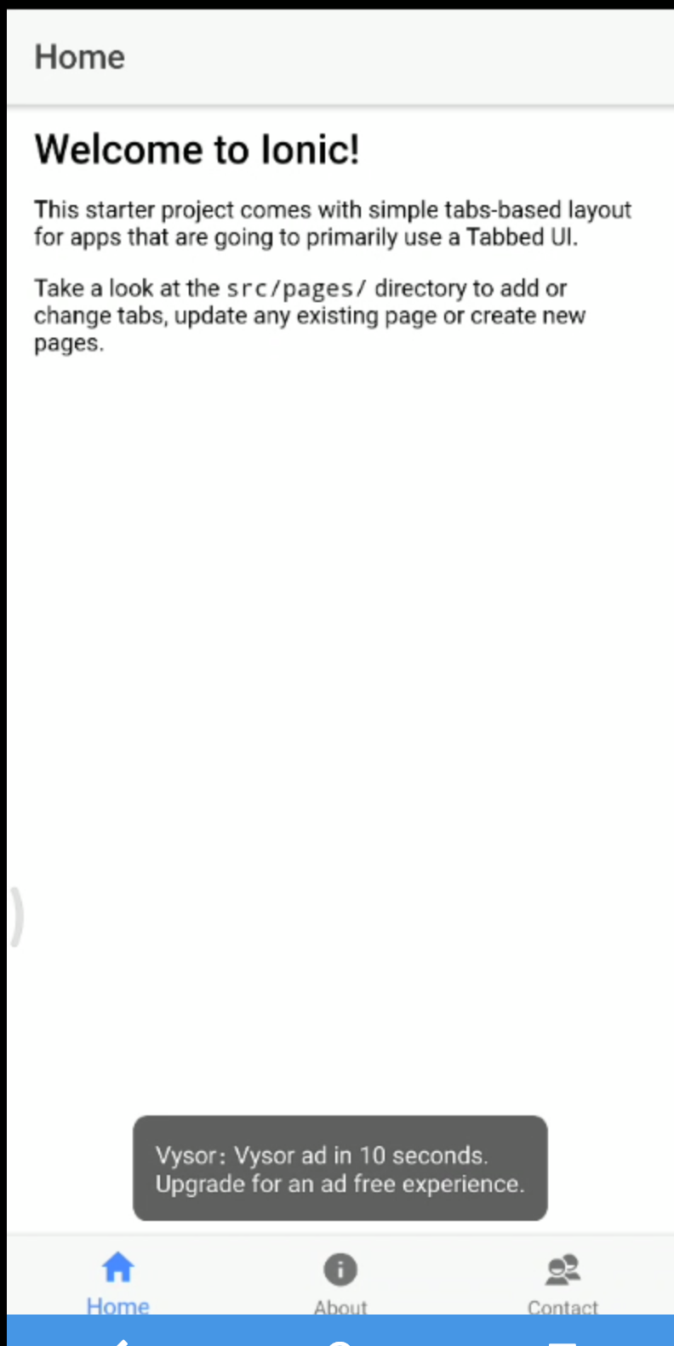
Building Profiles and Push Profiles (Deployed to emulator or device)
Running on a device
Command: ionic cordova run android / ionic emulate android
Build and push profile to device and emulator

